Slide 1
COURSE BASED PROJECT- M A C H I N E L E A R I N I G
HOUSE PRICE PREDICTION USING ML

Slide 2
INTRODUCTION
We propose to implement a house price prediction model of Bangalore, India. It’s a Machine Learning model which integrates Data Science and Web Development. Housing prices fluctuate on a daily basis and are sometimes exaggerated rather than based on worth. The major focus of this project is on predicting home prices using genuine factors. Here, we intend to base an evaluation on every basic criterion that is taken into account when establishing the pricing. The goal of this project is to learn Python and get experience in Data Analytics, Machine Learning.

Slide 3
Main motive
This project was made because we were intrigued and we wanted to gain hands-on experience with the Machine Learning Project
We are highly interested in anything related to Machine Learning, the independent project provided us with the opportunity to study and reaffirm our passion for this subject. The capacity to generate guesses, forecasts, and offer machines the ability to learn on their own is both powerful and infinite in terms of application possibilities. Machine Learning may be applied in finance, medicine, and virtually any other field. That is why we opted to base our idea on Machine Learning

Slide 4
LITERATURE SURVEY
Real Estate Property is not only a person's primary desire, but it also reflects a person's wealth and prestige in today's society.
Real estate investment typically appears to be lucrative since property values do not drop in a choppy fashion. Changes in the value of the real estate will have an impact on many home investors, bankers, policymakers, and others.
Real estate investing appears to be a tempting option for investors. As a result, anticipating the important estate price is an essential economic indicator.
According to the 2011 census, the Asian country ranks second in the world in terms of the number of households, with a total of 24.67 crores.
However, previous recessions have demonstrated that real estate costs cannot be seen.

Slide 5
The expenses of significant estate property are linked to the state's economic situation.
Regardless, we don't have accurate standardized approaches to live the significant estate property values. First, we looked at different articles and discussions about machine learning for housing price prediction.
The title of the article is house price prediction, and it is based on machine learning and neural networks. The publication's description is minimal error and the highest accuracy.
The aforementioned title of the paper is Hedonic models based on price data from Belfast infer that submarkets and residential valuation this model is used to identify over a larger spatial scale and implications for the evaluation process related to the selection of comparable evidence and the quality of variables that the values may require.
Understanding current developments in house prices and homeownership are the subject of the study. In this article, they utilized a feedback mechanism or social pandemic that fosters a perception of property as an essential market investment

Slide 6
METHODOLOGY
Data Collection
Linear Regression
Decision Tree Regression
Classification Trees
Random Forest Regression

Slide 7
Data
Data The data is the most important aspect of a machine learning assignment, to which special attention should be paid. Indeed, the data will heavily affect the findings depending on where we found them, how they are presented, if they are consistent, if there is an outlier, and so on. Many questions must be addressed at this stage to ensure that the learning algorithm is efficient and correct. To obtain, clean, and convert the data, many sub steps are required. We will go through these steps to understand how they've been used in my project and why they're helpful for the machine learning section

Slide 8
APPROACH
Problem Statement:
Create a model to estimate the price of houses in Bengaluru.
Dataset:
Dataset: https://www.kaggle.com/ameythakur20/bangalorehouse-prices

Slide 9
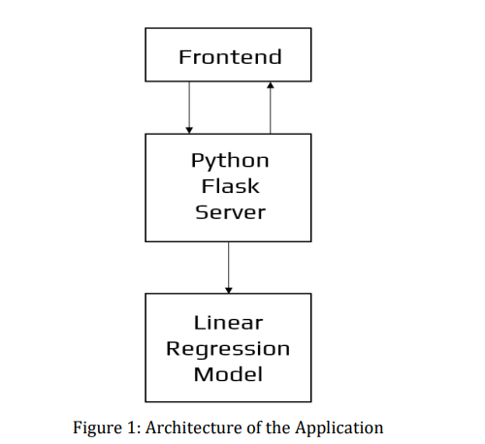
Project Architecture

Slide 10
Steps to Create Model
1. Import Libraries
2. Load Dataset
3. Exploratory Data Analysis
4. Data Cleaning 5. Feature Engineering
6. Dimensionality Reductions
7. Outlier Removal using Business Logic
8. Outlier Removal using Standard Deviation & Mean
9. Data Visualization
10. Building a Model
11. Test the Model for few properties
12. Export the tested model to a pickle file

Slide 11
TOOLS USED
1. Anaconda
2. Jupyter Notebook
3. Google Colaboratory
4. Flask
5. Heroku
TECHNOLOGIES USED
1.Python
2. HTML
3. CSS
4. Bootstrap

Slide 12
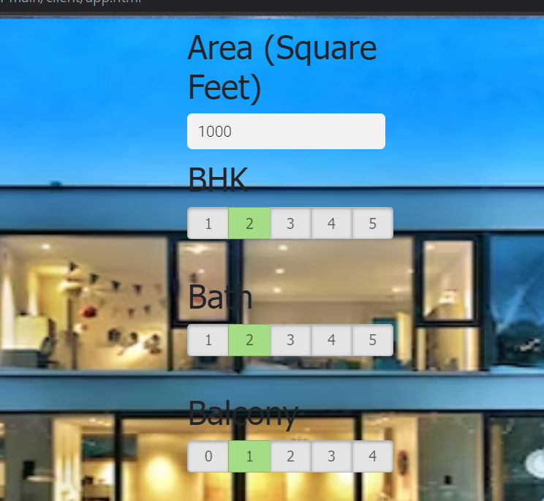
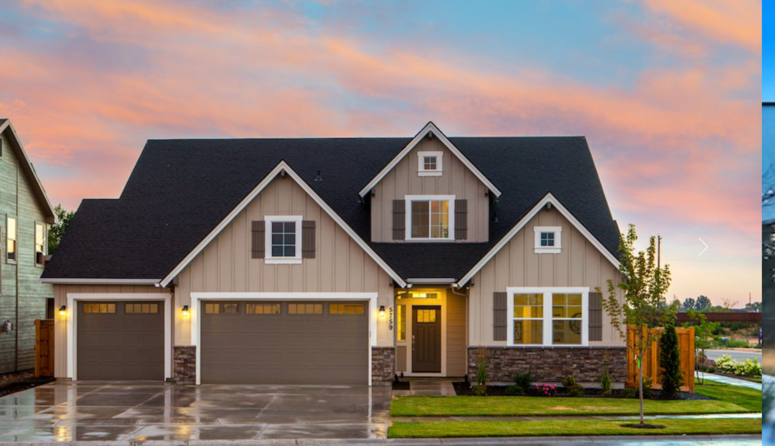
RESULTS

Slide 13
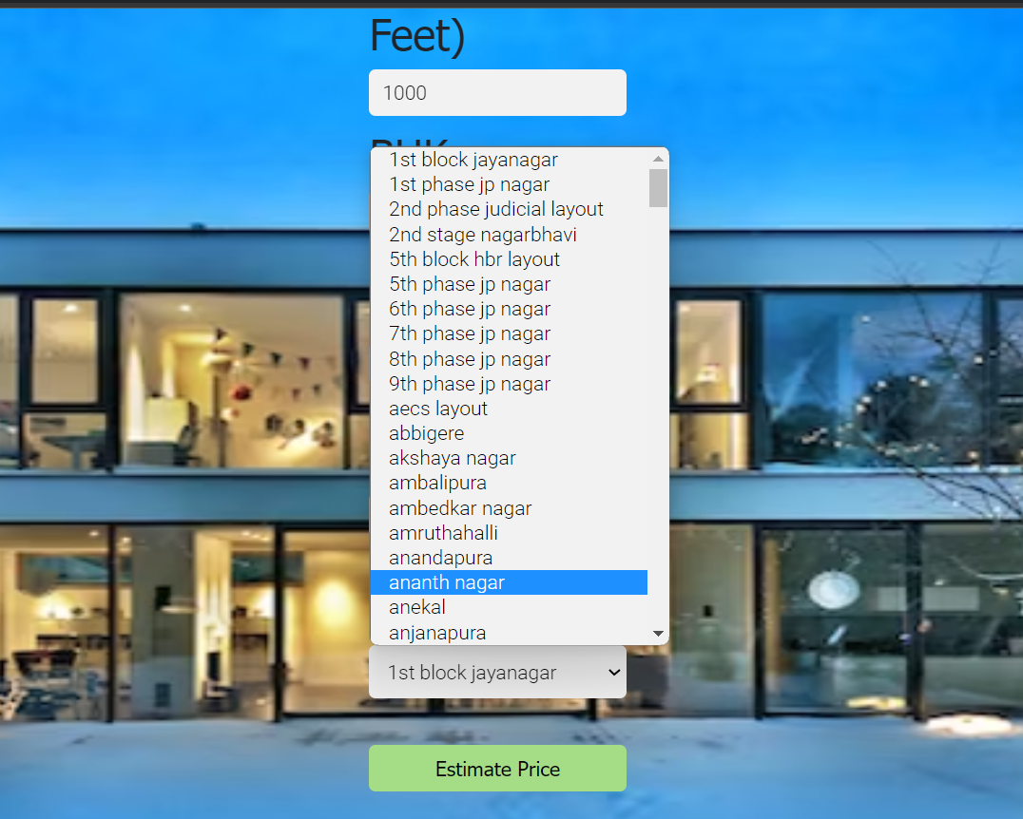
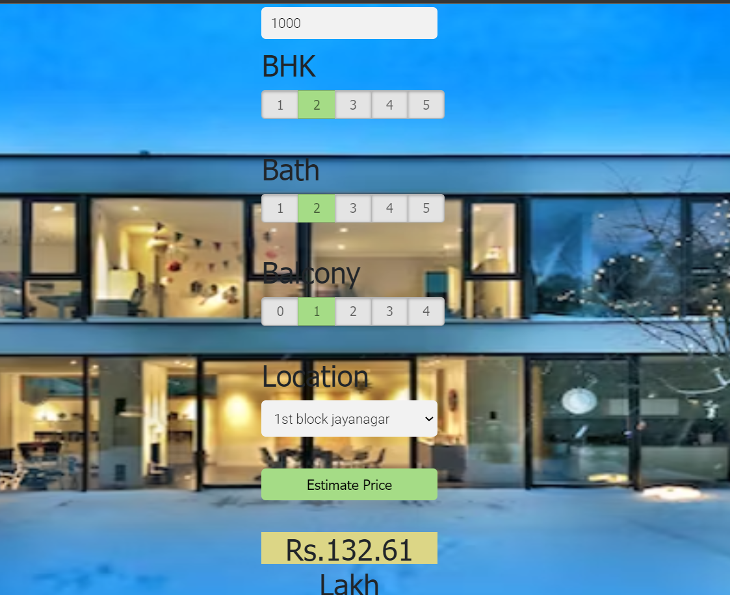

Slide 14
CONCLUSIONS
With several characteristics, the suggested method predicts the property price in Bangalore. We experimented with different Machine Learning algorithms to get the best model. When compared to all other algorithms, the Decision Tree Algorithm achieved the lowest loss and the greatest R-squared. Flask was used to create the website. Let's see how our project pans out. Open the HTML web page we generated and run the app.py file in the backend. Input the property's square footage, the number of bedrooms, the number of bathrooms, and the location, then click 'ESTIMATE PRICE.' We fo

